Slide 1
Functions and procedures

Slide 2
User defined functions Creating User-Defined Scalar Functions
UDFs can be used almost anywhere in a T-SQL statement.
UDFs can accept one or more parameters.
UDFs return one value.
UDFs can use logic such as IF blocks and WHILE loops.
UDFs can access data, though this is not a good idea.
UDFs can’t update data.
UDFs can call other functions.
The UDF definition must include a return value.

Slide 3
CREATE FUNCTION <scalar function Name> (<@param1> <data type1>,
<@param2> <data type2>)
RETURNS <data type> AS
BEGIN
<statements>
RETURN <value>
END

Slide 4
ALTER FUNCTION <scalar function Name> ([<@param1> <data type>,
<@param2> <data type>])
RETURNS <data type> AS
BEGIN
<statements>
RETURN <value>
END
DROP FUNCTION <scalar function name>

Slide 5
Using Table-Valued User-Defined Functions
The second type of UDF returns a record set instead of one value
You can’t use this type of UDF inline within a query
you can use it in place of a table or save the results into a temp table or table variable for use later in your script.
SELECT <col1>,<col2> FROM <schema>.<udf name>(<@param>)
SELECT <col1>,<col2> FROM <table1> CROSS APPLY <udf name>(<table1>.<col3>)

Slide 6
EXcercise
Use the AdventureWorks2012 database to complete this exercise.
1. Create a user-defined function called dbo.fn_AddTwoNumbers that accepts two integer parameters. Return the value that is the sum of the two numbers. Test the function.
2. Create a user-defined function called dbo.Trim that takes a VARCHAR(250) parameter. This function should trim off the spaces from both the beginning and the end of the string. Test the function.
3. Create a function dbo.fn_RemoveNumbers that removes any numeric characters from a VARCHAR(250) string. Test the function. Hint: The ISNUMERIC function checks to see whether a string is numeric. Check Books Online to see how to use it.
4. Write a function called dbo.fn_FormatPhone that takes a string of ten numbers. The function will format the string into this phone number format: “(###) ###-####.” Test the function.

Slide 7
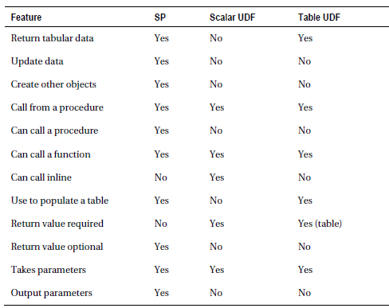
Stored Procedures

Slide 8
CREATE PROC[EDURE] <proc name> [<@param1> <data type>,<@param2> <data type>] AS
<statements>
[RETURN <INT>]
ALTER PROC[EDURE] <proc name> [<@param1> <data type>,<@param2> <data type>] AS
<statements>
[RETURN <INT>]
EXEC <proc name> <param values>

Slide 9
Using Default Values with Parameters
CREATE PROC[EDURE] <proc name> <@param1> <data type> = <default value> AS
<statements>
[return <value>]

Slide 10
Using the OUTPUT Parameter
CREATE PROC[EDURE] <proc name> <@param> <data type> OUTPUT AS
<statements>
[return <value>]
GO
DECLARE <@variable> <data type>
EXEC <proc name> [<@param> =] <@variable> OUTPUT
PRINT <@variable>

Slide 11
Saving the Results of a Stored Proc in a Table
INSERT [INTO] <table name> EXEC <stored proc> [<@param value>]

Slide 12
Using a Logic in Stored Procedures
DEMO

Slide 13
Excercise
1. Create a stored procedure called dbo.usp_CustomerTotals that displays the total sales from the TotalDue column per year and month for each customer. Test the stored procedure.
2. Modify the stored procedure created in question 1 to include a parameter @CustomerID. Use the parameter in the WHERE clause of the query in the stored procedure. Test the stored procedure.
3. Create a stored procedure called dbo.usp_ProductSales that accepts a ProductID for a parameter and has an OUTPUT parameter that returns the total number sold for the product. Test the stored procedure.

